Slide 1
Auto-completion for Writing Network Configurations
Ahsan Mahmood, Aaron Gember-Jacobson

Slide 2
Introduction
A network’s backbone is its routing control plane
Set of rules that dictate how the network should behave
Control plane logic is distributed across the network
Each router has its own configuration file that tells it what to do

Slide 3
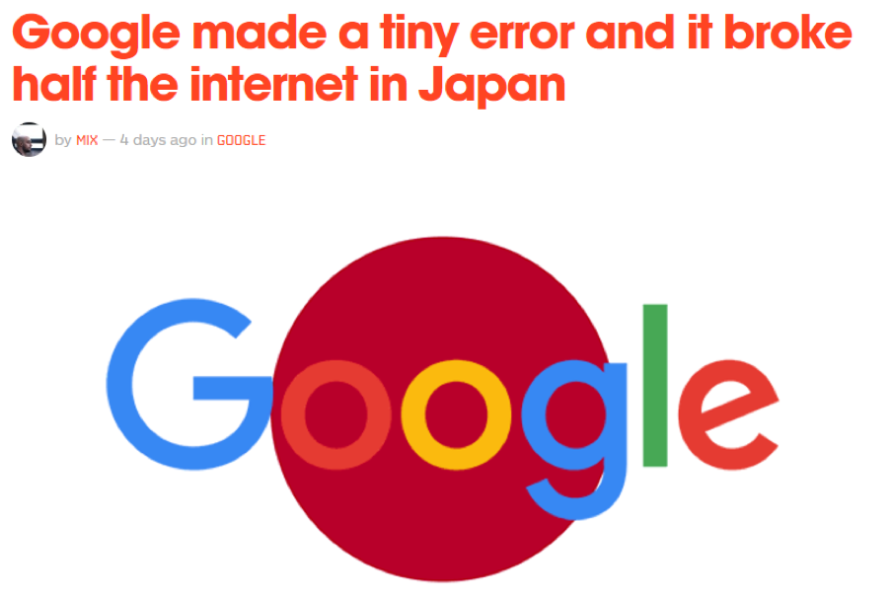
Problem Statement
Network configurations are often very complex
Small mistakes can lead to big problems
Need for tools that can fix broken network configurations or prevent errors

Slide 4
Possible Solutions
Error-free Internet
Configuration Synthesis
Development Tools
Network Verification
Command Line Interfaces
Templates
Notes:
Present our work in context of the larger goal: a step towards clippy

Slide 5
Outline
Background
Methodology
Results

Slide 6
Network Configurations - Background
!
version 12.4
!
hostname B
!
access-list 1 deny 12.0.0.0 0.255.255.255
access-list 1 permit any
!
interface GigabitEthernet0/1
description INFRA:C:Gi0/1
ip address 1.0.1.1 255.255.0.0
ip ospf cost 1
ip access-group 1 in
!
router ospf 1
redistribute connected
network 3.0.0.0 0.0.255.255 area 0
network 1.0.0.0 0.0.255.255 area 0
!
end
Token
Example Cisco Configuration
What can we infer?
Device name is B
Access control list will deny any IP address starting with 12
Connected to two other routers
IP Address
Stanza
Notes:
What are the rules?

Slide 7
Our Vision
Writing assistant for building network configurations
Think Clippy for networks! (But not as terrible)
Ambitious goals
Suggests complete stanzas
Automatically fills in parameters
Suggests improved syntax
This thesis works towards a concrete first step
Suggesting tokens!
Notes:
Improved/concise
We want all of this, so where do we start? Tokens!

Slide 8
Challenges
Routers have different roles
Configurations often have many parameters which add variance
We may need long histories of snapshots
Some networks may not have any existing configurations to help build a model
Notes:
Roles: core (w/in Colgate) vs edge (for internet)
Parameters: such as device name – go back to explain

Slide 9
Autocompletion Engine - Background
Recent research on software systems has shown that codebases tend to contain regularities much like natural languages
Same combination of words tend to be used more often
Allows us to use Natural Language Processing for code completion
Neat!
Hypothesis: A similar regularity exists for network configurations
Notes:
Researchers have discovered that software systems tend to look like our spoken/written languages in that they contain “regularities” – and by that we mean most of our language uses the same combination of phrases, logic etc.

Slide 10
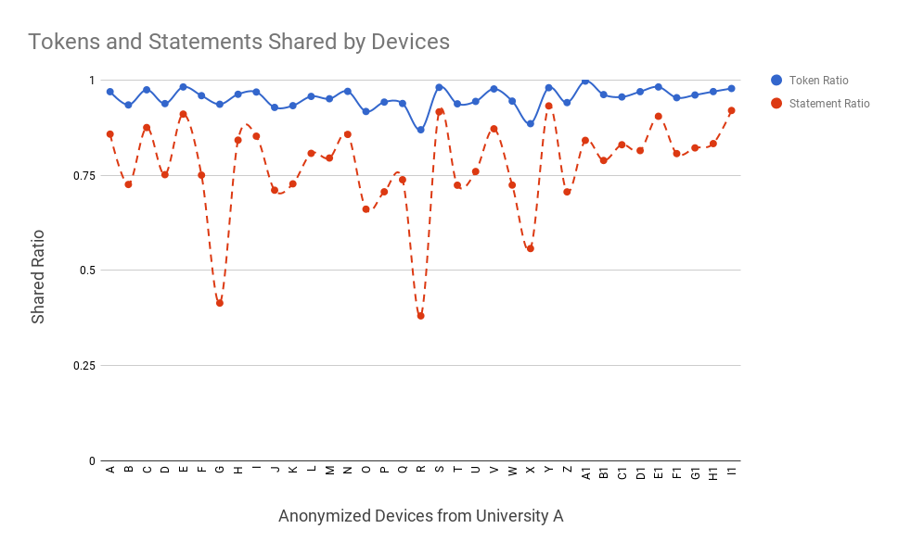
What regularity?
Most of a device’s configuration can be reconstructed from existing configurations
Previous measurement studies have revealed extensive use of templates in network configurations
What do we get?
NLP on configurations
Notes:
Our observations indicate that most of a device’s configuration could be reconstructed from existing configurations
If theres regularity in our configs, we get NLP for free

Slide 11

N-gram Models
N-grams are simple techniques that allow us to model how likely one token is to follow another one
Using previous $n−1$ tokens, we predict the probability of the next one
$P\left(w_{n}\right| w_{n−1},w_{n−2},w_{n−3}, …,w_{1}) ≈P\left(w_{n}\right| w_{n−1}, …,w_{n−N+1})$
We use likelihood estimators to score our N-grams

Slide 12
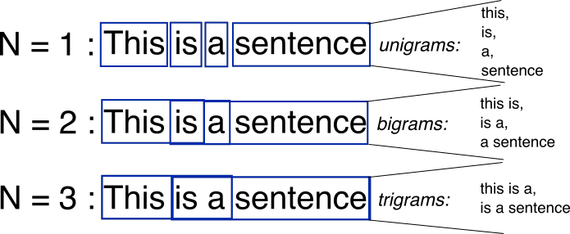
N-gram Example

Slide 13
Placeholders
!
version 12.4
!
hostname B
!
access-list 1 deny IPADDRESS SUBNET
access-list 1 permit any
!
interface GigabitEthernet#ID
description DESCRIPTION
ip address IPADDRESS SUBNET
ip ospf cost 1
ip access-group 1 in
!
router ospf 1
redistribute connected
network IPADDRESS SUBNET area 0
network IPADDRESS SUBNET area 0
!
end
We employ a networking- specific optimization predicated by our observation that IP prefixes are often unique to devices
We replace these prefixes and certain other tokens with generic prefix tokens
Notes:
Engine can help you figure out whether you need ipadress here or not

Slide 14

What about our data?
“We don’t have better algorithms. We just have more data.”
- Peter Norvig
“It’s not my fault. Our data sucks!”
- Me from the past

Slide 15
Our cute little dataset
University | Number of Configurations | Total Lines | Average Lines
A | 35 | 73K | 2.1K
B | 26 | 61K | 2.3K
C | 24 | 67K | 2.8K
Table 1: Acquired configurations from three large university networks

Slide 16
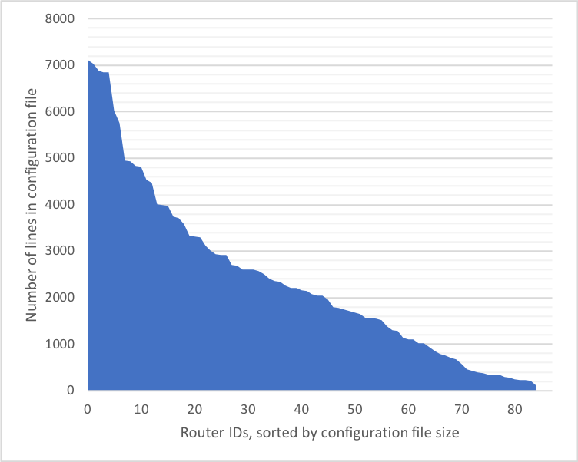
Our cute little dataset
Figure 1: Our data contains a myriad of configuration sizes

Slide 17
Testing Methodology
“Rebuild” the test configurations token-by-token
A prediction is marked as successful when we suggest the correct token within three results

Slide 18
Testing Methodology
Configuration “Rebuilt” Using Model
Original Configuration
. . .
!
access-list 1 deny IPADDRESS SUBNET
access-list 1 permit any
!
interface GigabitEthernet#ID
description DESCRIPTION
ip
. . .
!
access-list 1 deny IPADDRESS SUBNET
access-list 1 permit any
!
interface GigabitEthernet#ID
description DESCRIPTION
ip address IPADDRESS SUBNET
ip ospf cost 1
ip access-group 1 in
!
router ospf 1
redistribute connected
network IPADDRESS SUBNET area 0
network IPADDRESS SUBNET area 0
!
end
address
ospf
address
ssh

Slide 19
Testing Methodology
“Rebuild” the test configurations token-by-token
A prediction is marked as successful when we suggest the correct token within three results
Perform leave-one-out cross validation

Slide 20
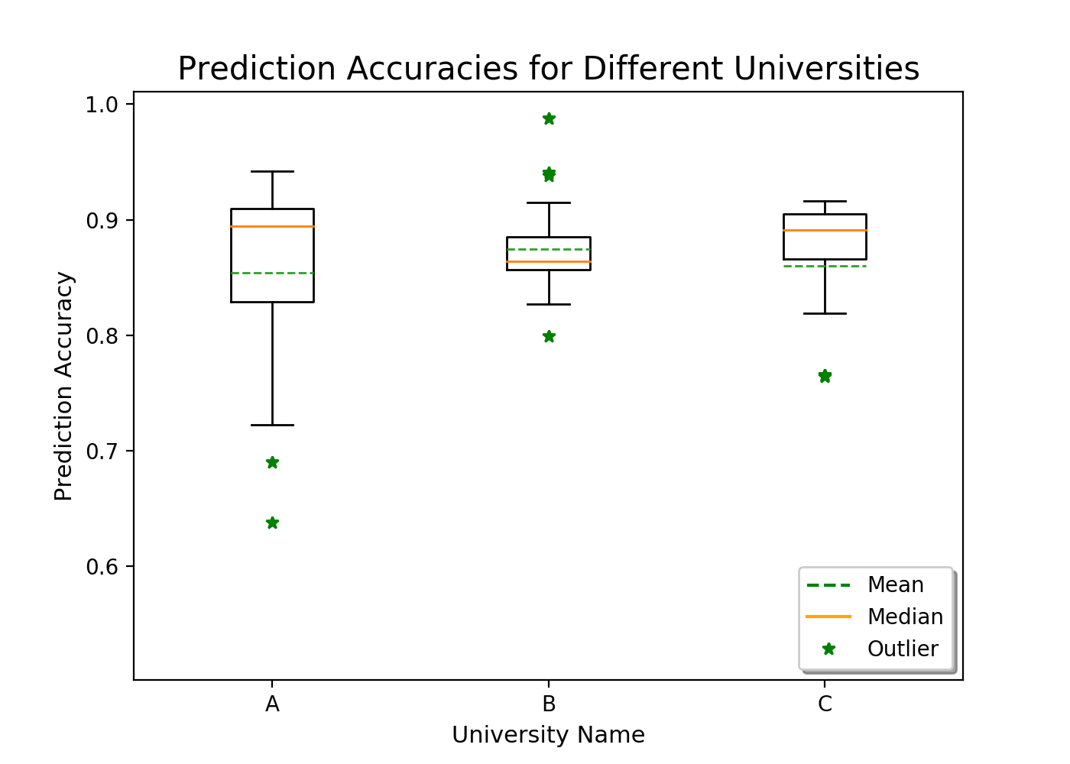
Overall Performance
Figure 1: High prediction accuracy (>85%) for the majority of routers.

Slide 21
Challenges
Routers have different roles
Configurations often have many parameters which add variance
We may need long histories of snapshots
Some networks may not have any existing configurations to help build a model
Notes:
Roles: core (w/in Colgate) vs edge (for internet)
Parameters: such as device name – go back to explain

Slide 22
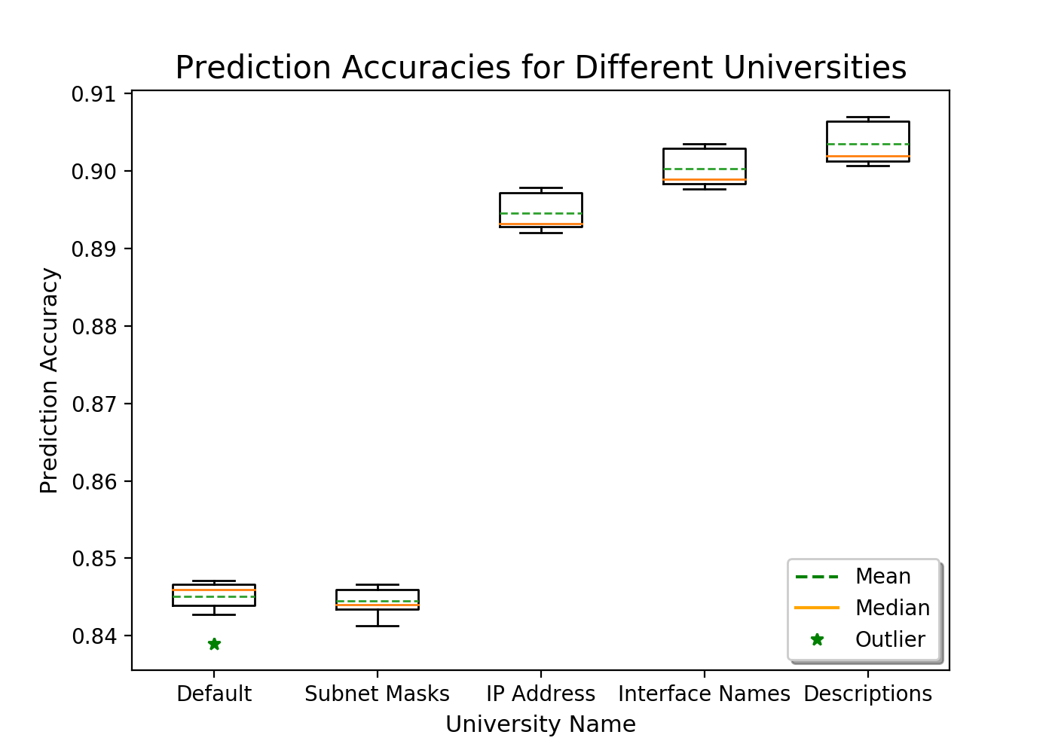
How well did our placeholders perform?
Figure 2: Placeholders improve accuracy by 5% higher.
Notes:
Diminishing returns
Explain WHY we see these diffs
More unique things, harder it is to predict – vl#ians example

Slide 23
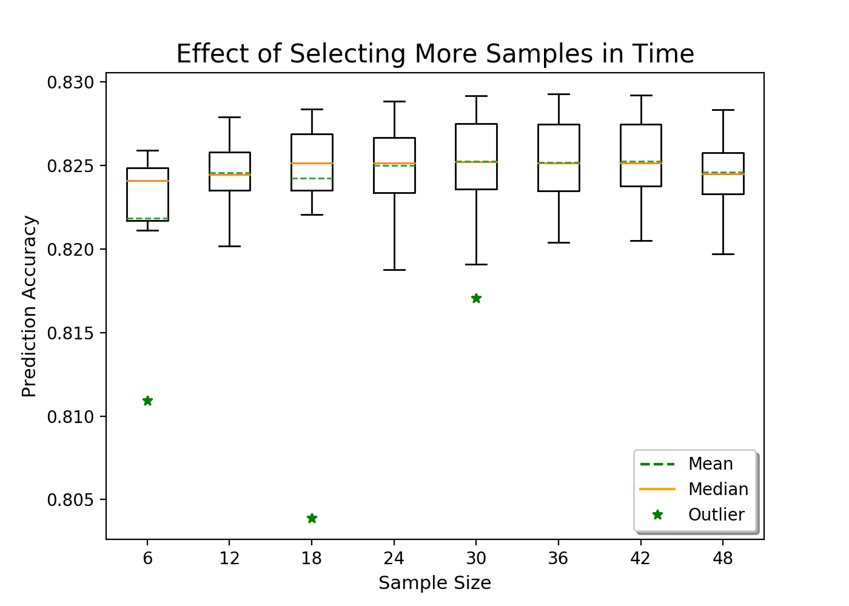
How does the model perform for small datasets?
Figure 3: Smaller sample sizes give surprisingly high accuracies
Notes:
Number of months / length of history x-axis label
Nw configs dnt change a lot over time
Suttle diffs dnt significantly change our model
Why does this trend exist? Maybe some measurement study configs dnt change over time

Slide 24
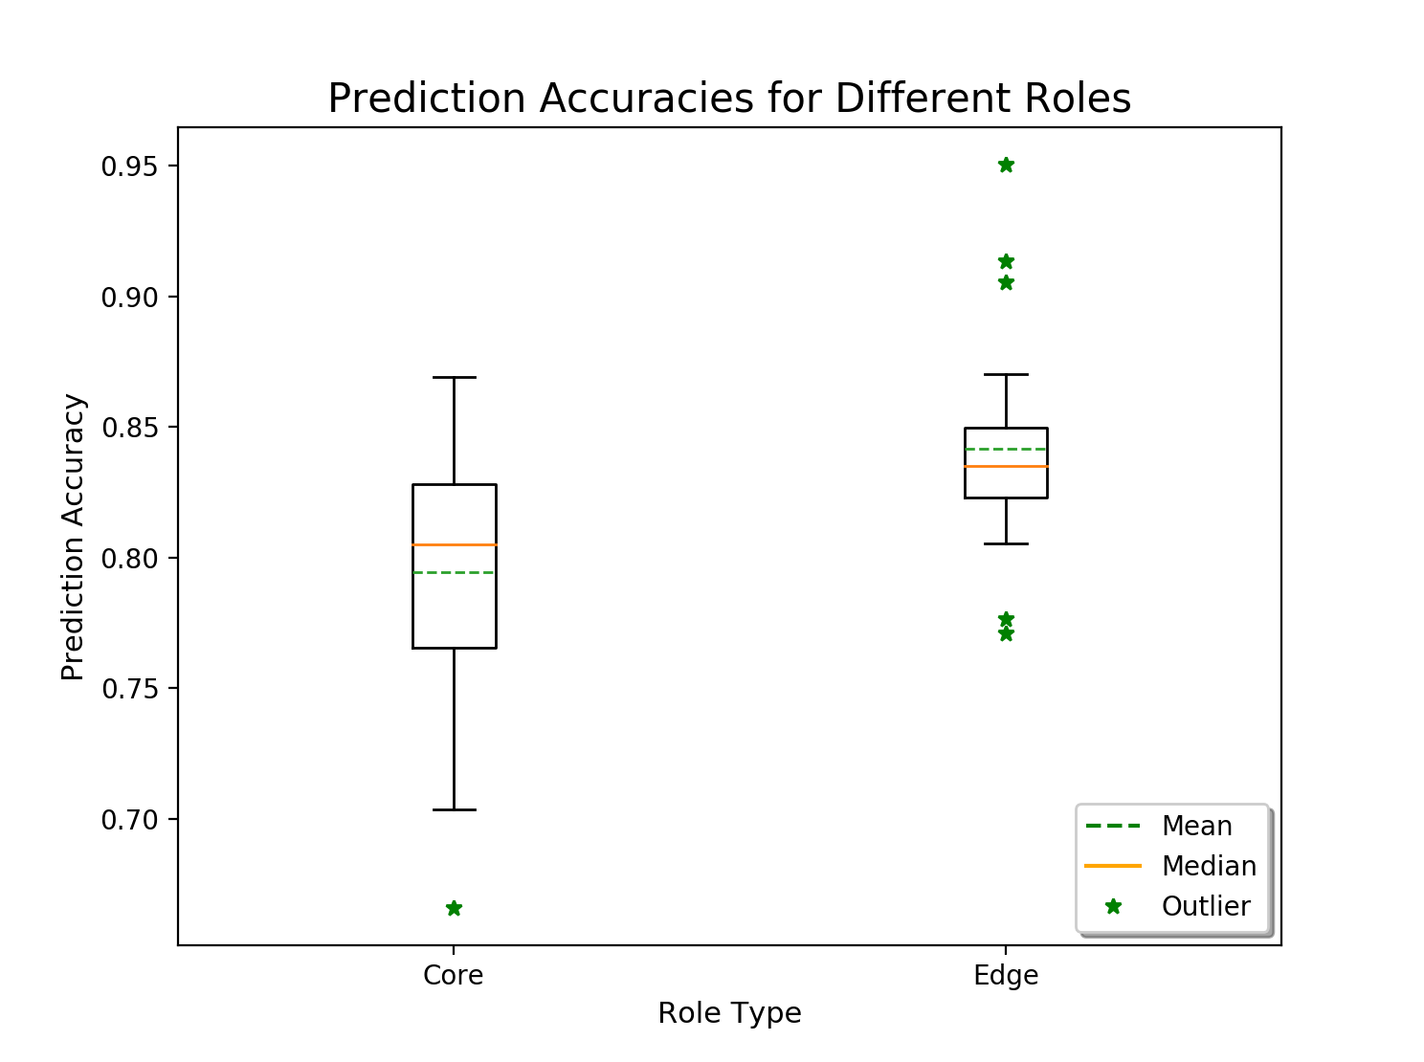
What about different router roles?
Figure 4: Models trained on different roles don’t seem to fare much better than our overall average
Notes:
Explanation
Add default
Suggest that graph shows that tehre may not be too much diff b/w roles
Labels /roles may be coarse - may need to be more fine grained about dividing them
Number of devices

Slide 25
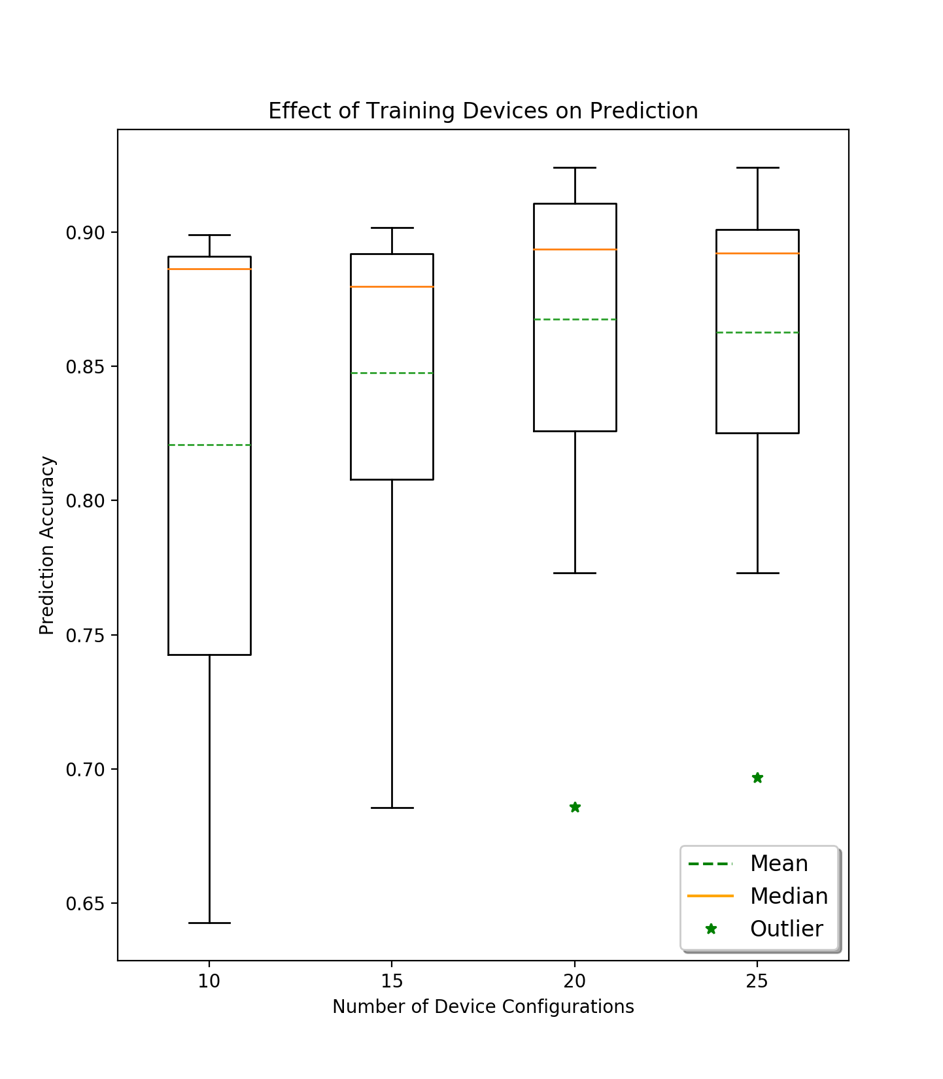
How does the model perform for small datasets?
Figure: Smaller sample sizes give surprisingly high accuracies
Notes:
Uve seen most things

Slide 26
Possible Future Work
Evaluate our model against the current state of the art: tab-completion in CLIs on modern routers
Using larger n-grams to suggest complete statements
Completing entire lines or even stanzas
Not just based on syntax but also desired goals using input from operators

Slide 27
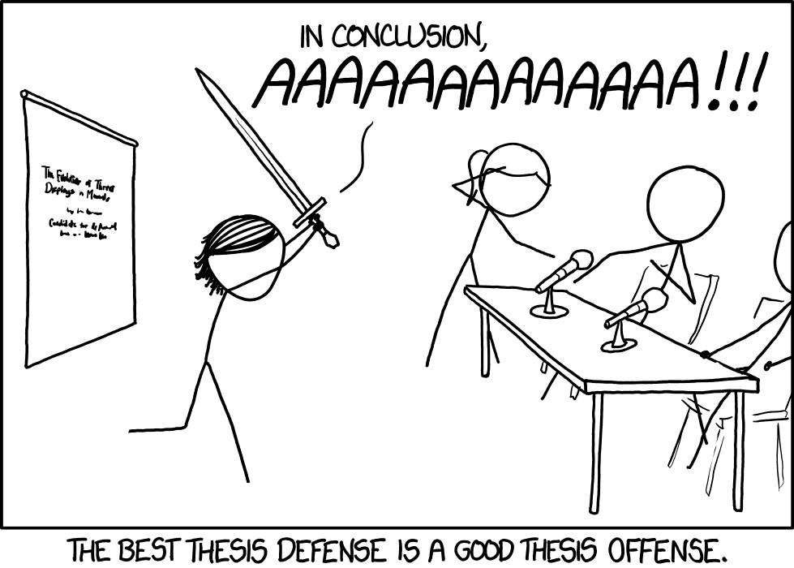
Thank you!

